Slide 2
Presentation Outline
Abstract
Introduction
Background, Problem Statement, Objectives, Justification
Recap
- Literature review.
- Proposed Methodology.
Designs
- Discharge flow control
- Discharge collection
Expected outcomes
Time plan and Budget.
Way Forward
Notes:
10/13/2020
2

Slide 3
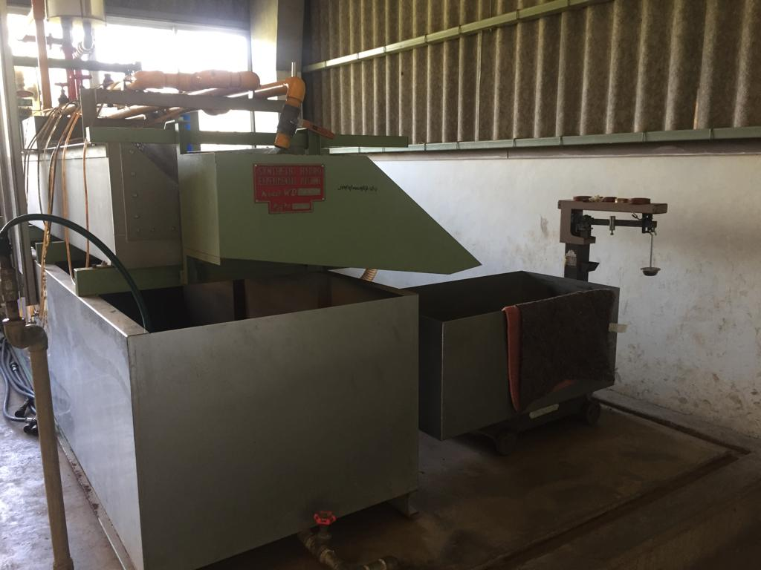
Synthetic Hydro-Experimental Machine

Slide 4
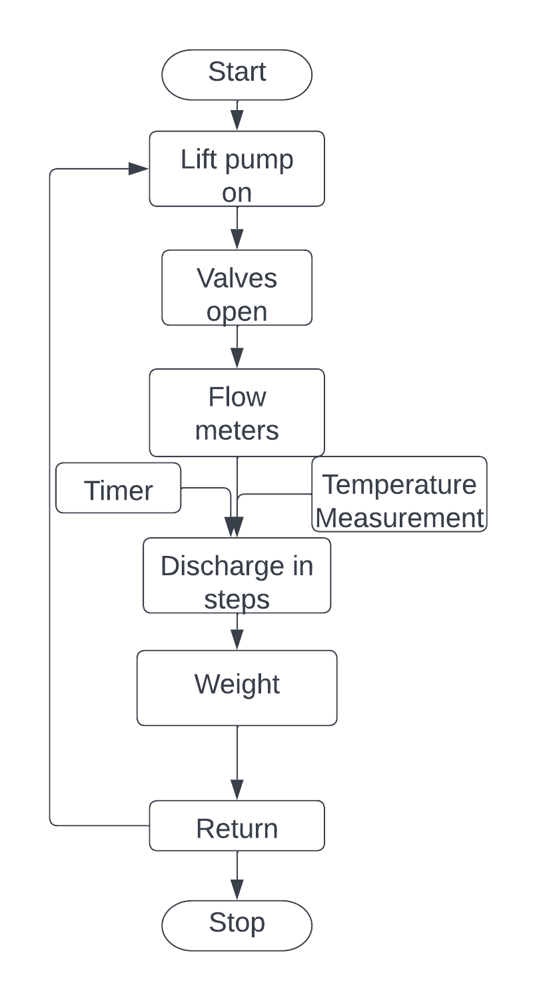
Introduction: Background
Fluid flow measurement
Quantifying a property of an uninterrupted flow.
Flow meters
Turbine flow meter, rotameter, venturi, and orifice.
Bernoulli’s Theorem.
Synthetic Hydro-Experimental Machine
Consists of venturi, and orifice
Establishing a relationship between discharge, differential pressure, and the coefficient of discharge.
Experiment procedure
Notes:
Fluid flow property measured and related to the flow. (relating pressure to the flow)
Each flow meter alter a physical property and the measures the change.
Bernoulli’s theorem – an increase in the velocity of a fluid occurs simultanously with a decrease in static pressure.
Procedure

Slide 5
Introduction: Problem Statement
Fluid flow experiments required one to synchronize discharge collection with time and temperature measurement.
Current state of the Synthetic Hydro-Experimental Machine.
Determination of steps based on human intuition
Discharge collection synchronization by a minimum of two operators
Incremental weight measurement.
Results in Cd outside the tolerable range.
Automated Synthetic Hydro-Experimental Machine
Precise discharge flow control.
Automated discharge collection.
Automate discharge weight and temperature measurement.

Slide 6
Introduction: Objectives
Main Objective
To automate the discharge collection process of the Synthetic Hydro-Experimental Machine.
Specific Objectives
To design an automated discharge flow control unit that can precisely discharge in steps.
To design and fabricate a discharge collection unit with automated weight, time and temperature measurements.
To design a user interface and the control algorithm.

Slide 7
Recap
Methodology
Discharge flow control : Choices: Servo, and Stepper motors
Main considerations: Torque requirements and step size
Discharge collection : Choices: Electromagnetics, Piezoelectric, Motor, Tank shape
Main considerations: Response time, Consistency
Interface and Control : Choices: LCD with keypad, knobs, and touch, STM32, ESP, Pi
Main considerations: Ergonomics, Processing capacity, power requirements.
Literature
Existing Technologies
- Computational fluid dynamics
- Analytical predictions
Related Works
- Electromagnetic Actuation – Automated Water Sampler
- Pneumatic Control
– Pneumatic Dispenser
Gaps
- Credibility of the experiment.
- Resources
- Error margins

Slide 8
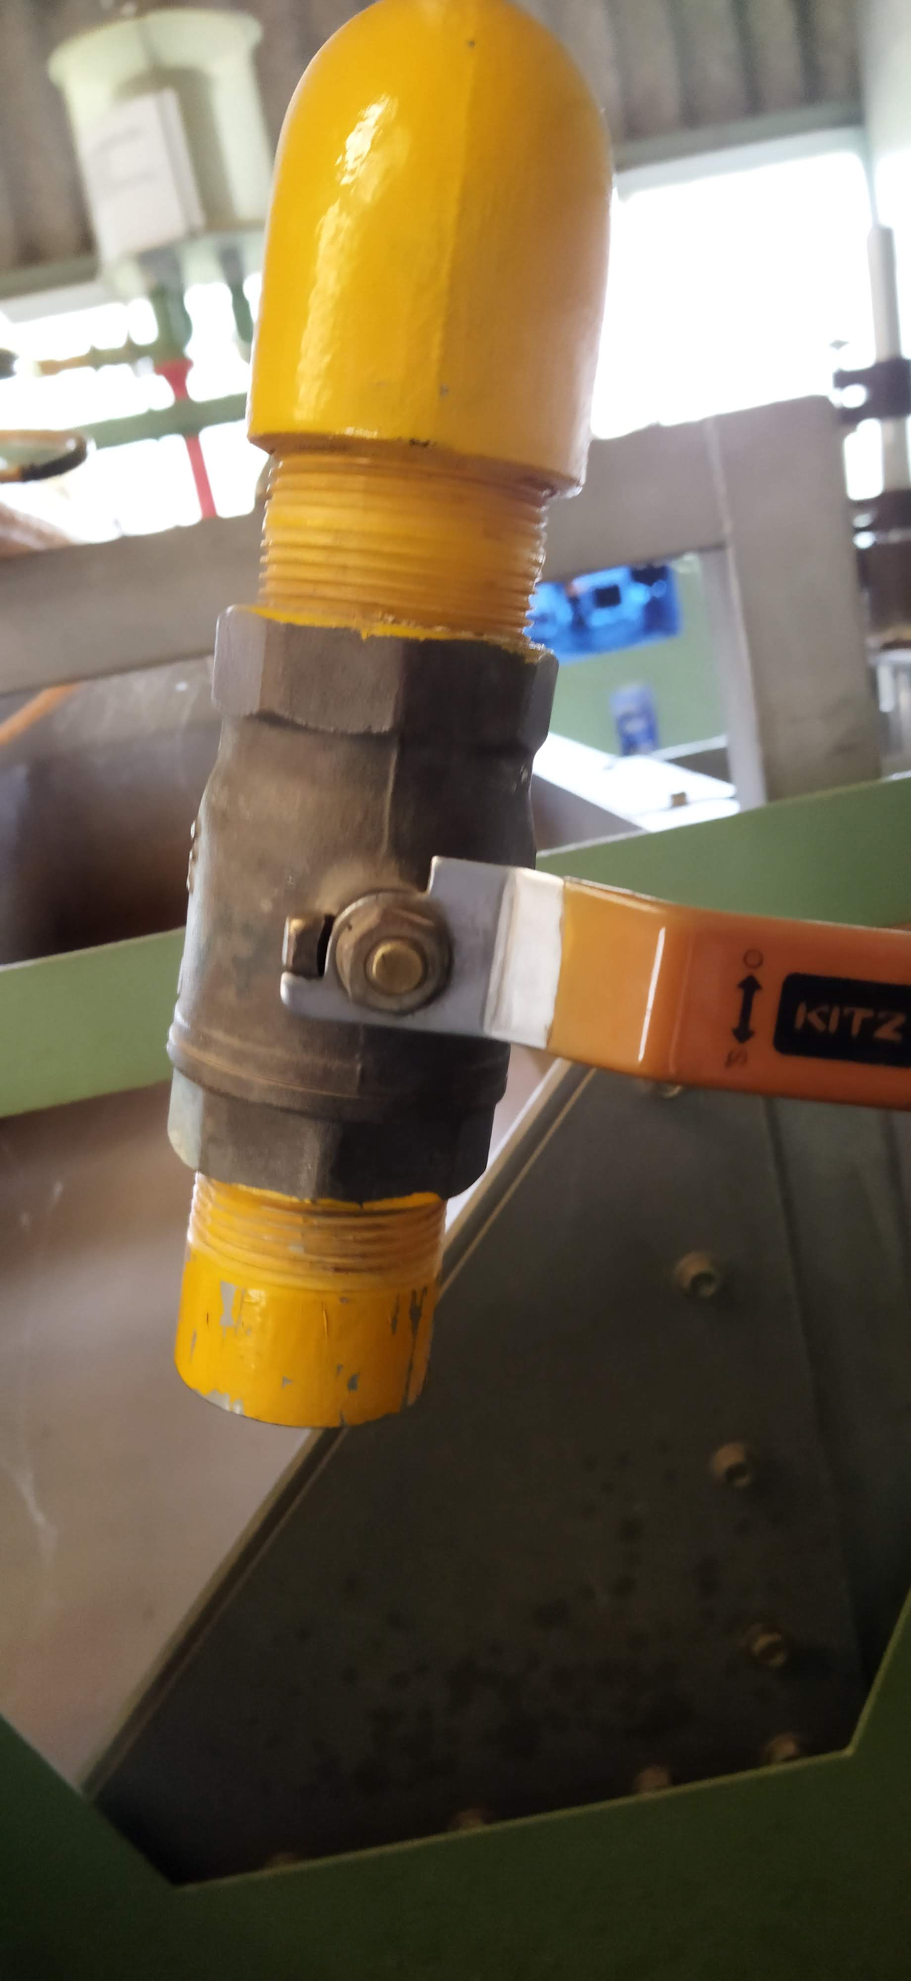
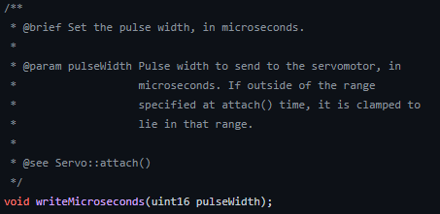
Design: Discharge flow control
Requirements: - Utilizing the existing ball valve
- Step sizes
- Torque requirement
Considerations
Stepper Motors
Micro-step driver.
Typically 1.8⁰ and sometimes 0.9⁰
Low-speed application < 1500rpm
Servo Motors
Optional driver
High-speed application > 1500rpm
Smaller angles, typically 1⁰
Choice
Servo Motors
Justification
Smaller angles less than 1⁰
can be achieved by writing smaller pulse widths.
Smaller step angles = more steps

Slide 9
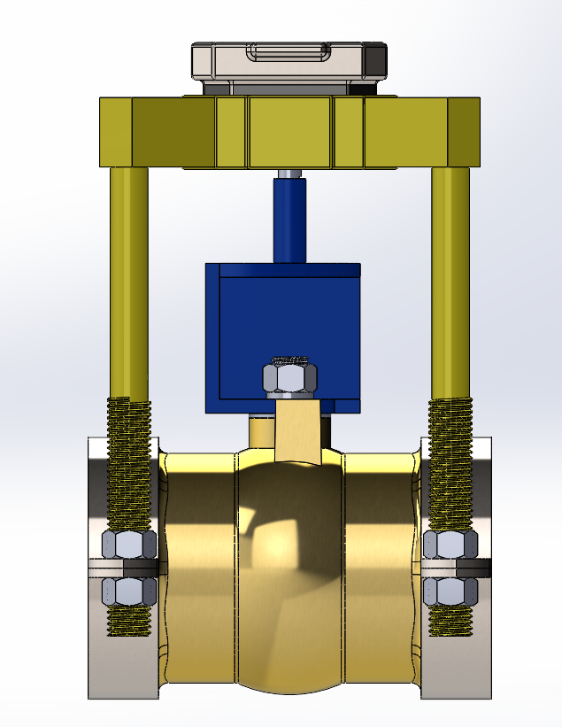
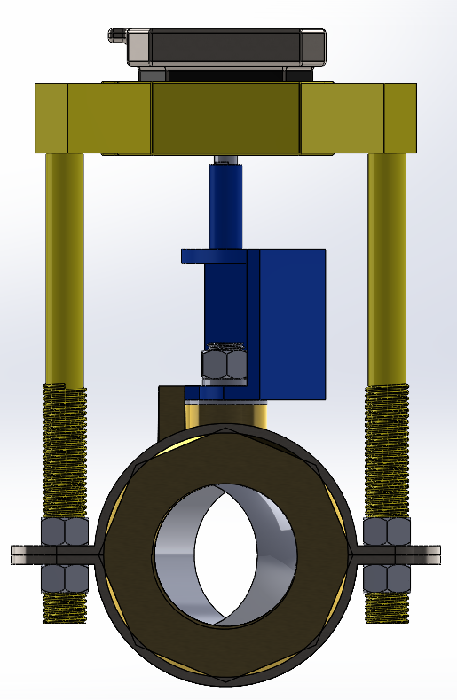
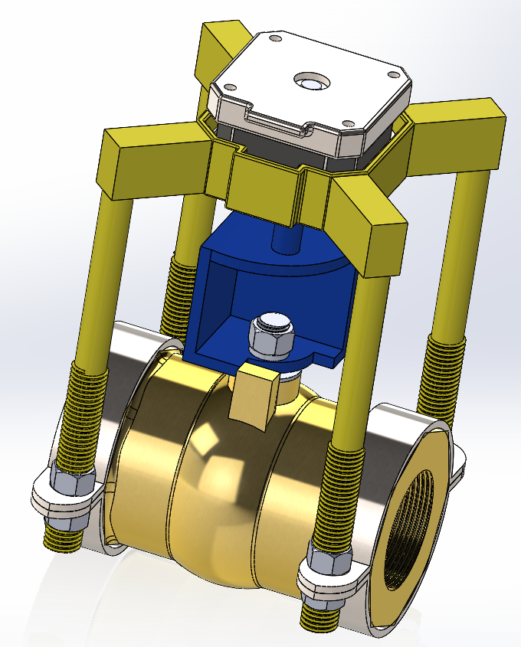
Design: Discharge flow control
Stepper Motor
Interface
Pipe clamps

Slide 10
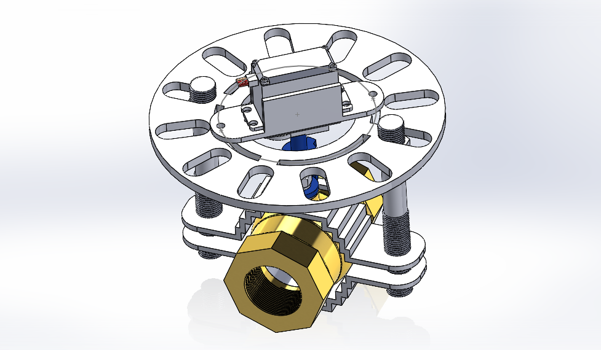
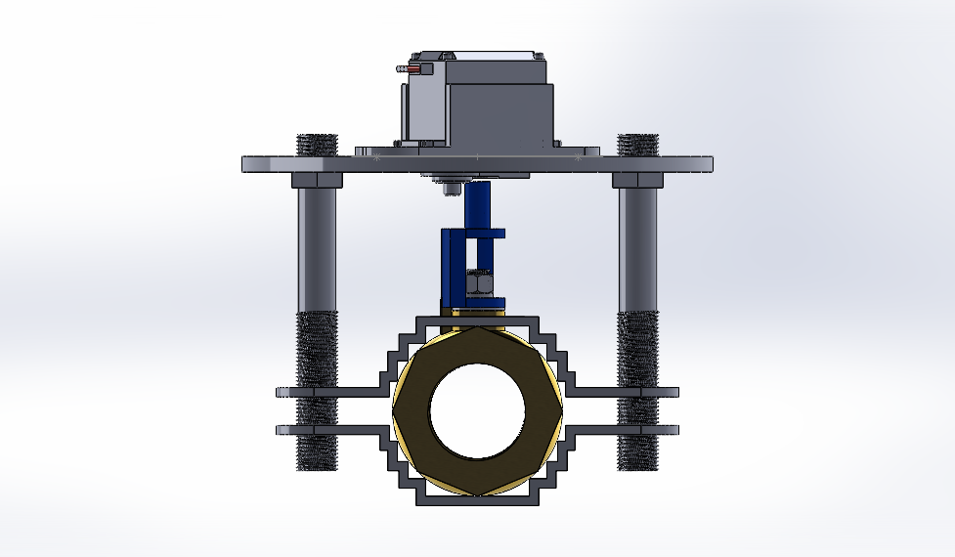
Designs: Discharge Flow Control cont..

Slide 11
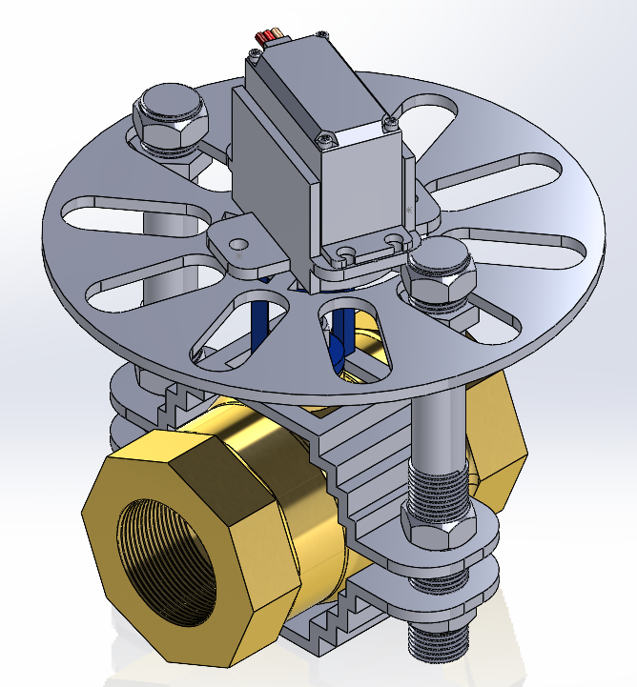
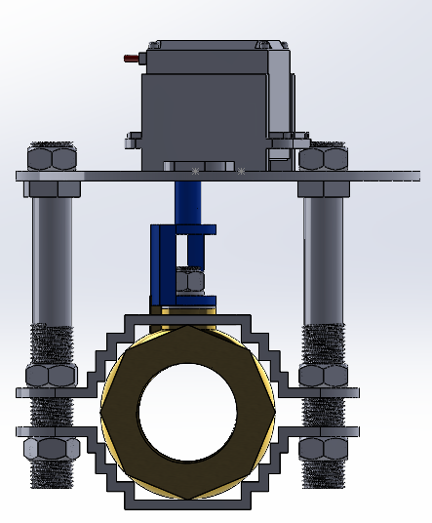
Designs: Discharge flow control redesigned

Slide 12
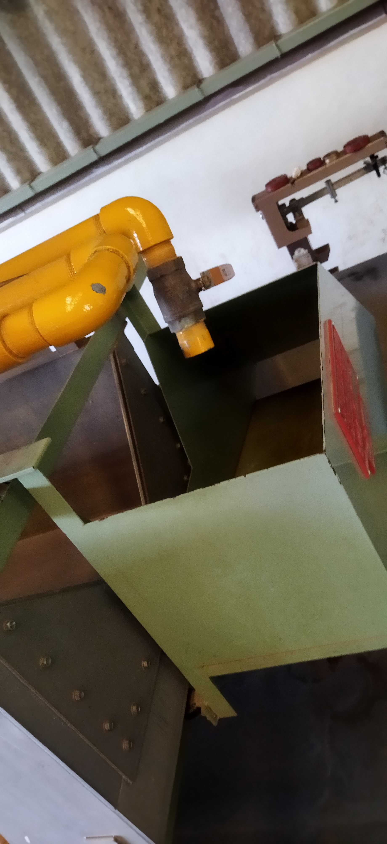
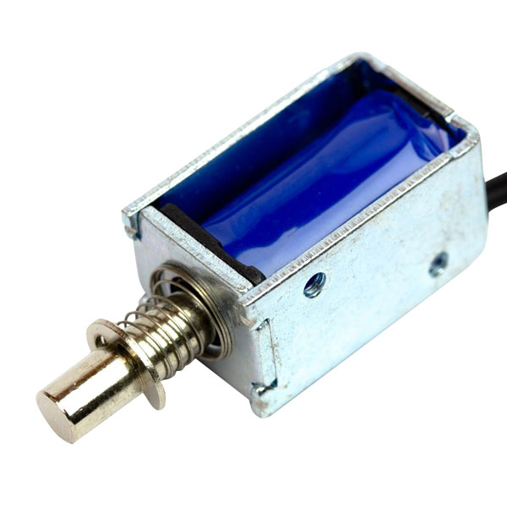
Design: Discharge collection unit
Flow Diversion
Requirements: - Response time.
- Force requirements.
Considerations
Electromagnetic Actuator
Linear push and pull.
Strength in a stroke = 5N/10mm
Servo motor
Bidirectional rotary motion.
Variable torque
Choice
Electromagnetic Actuator
Justification
Direct linear push and pull motion
Simple kinematic mechanism to amplify the displacement.

Slide 13
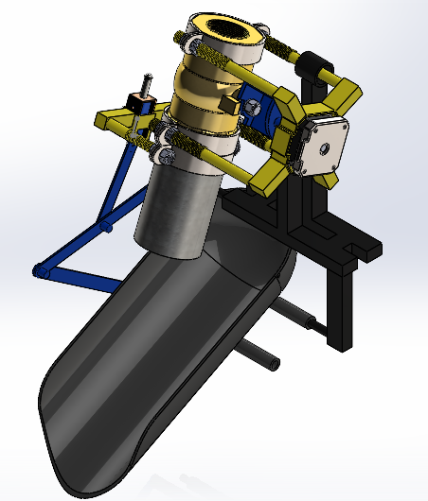
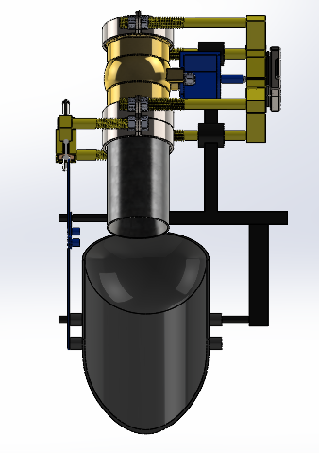
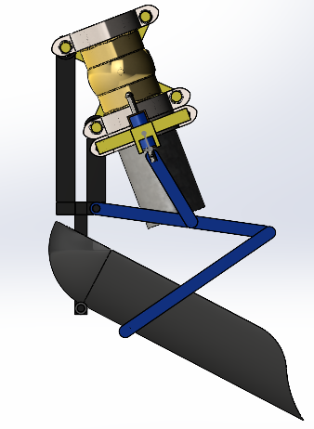
Design: Discharge Collection Unit

Slide 14
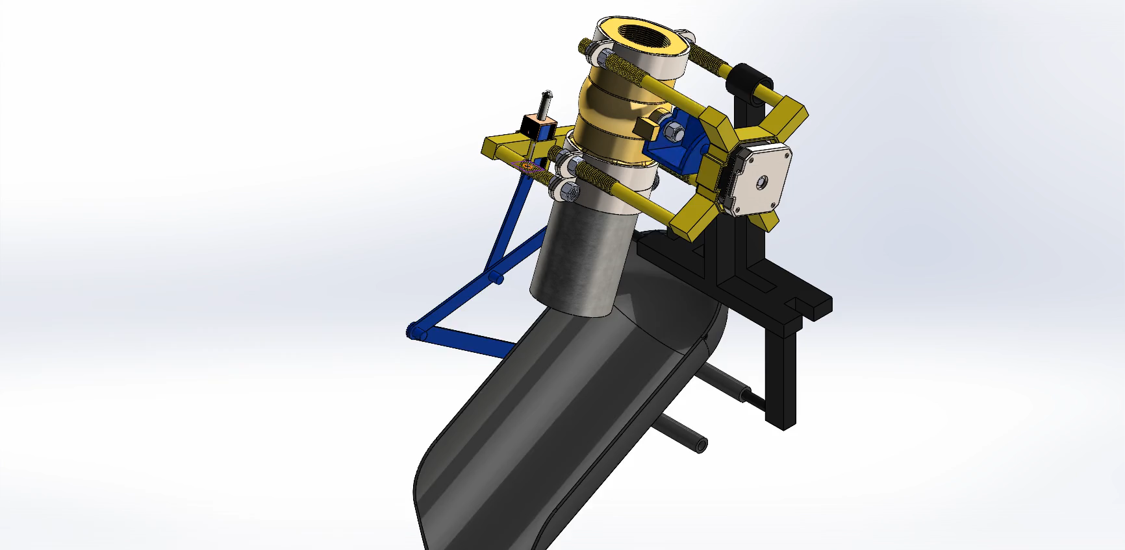
Designs: Motion Study

Slide 15
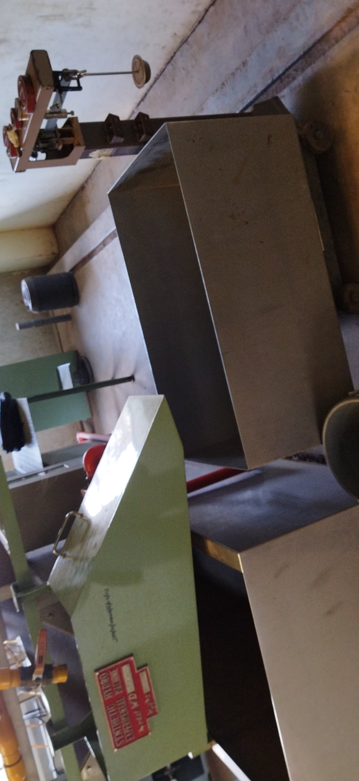


Design: Discharge collection unit
Discharge collection tank.
Requirements: - Motivated discharge
- Capacity of not less than 20 Liters.
Considerations
Choice
Horizontal Cylindrical tank.
Justification
Motivated discharge
Easier to fabricate

Slide 16
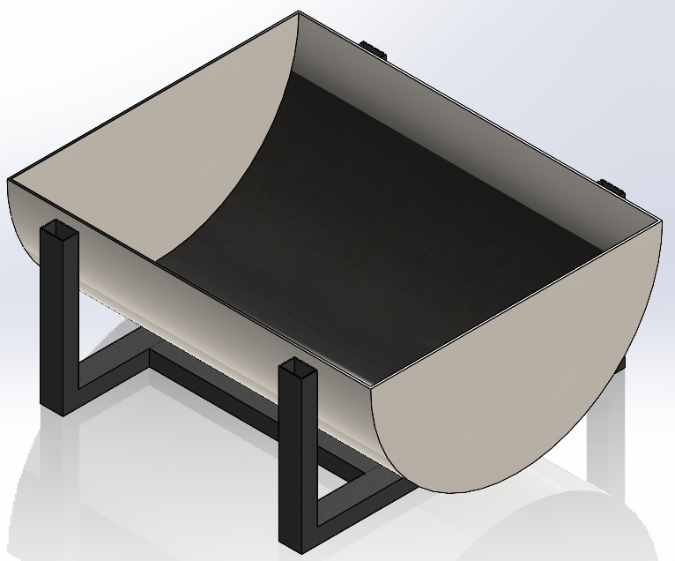
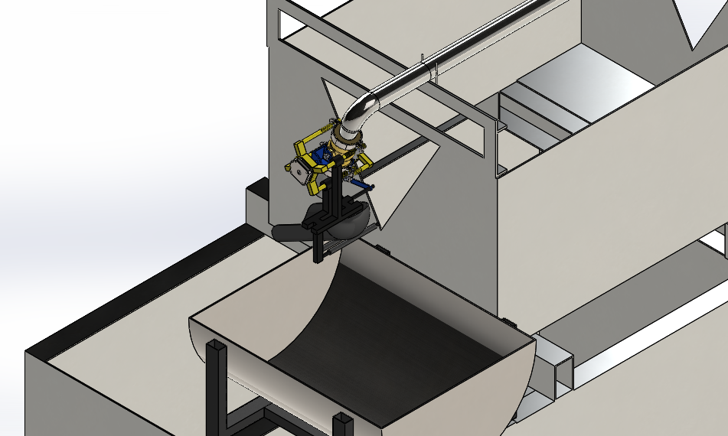
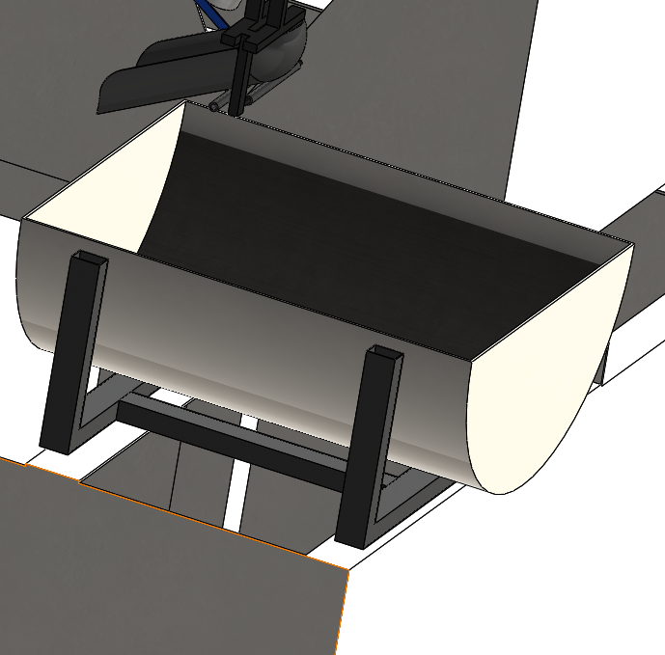
Design: Discharge collection unit

Slide 17
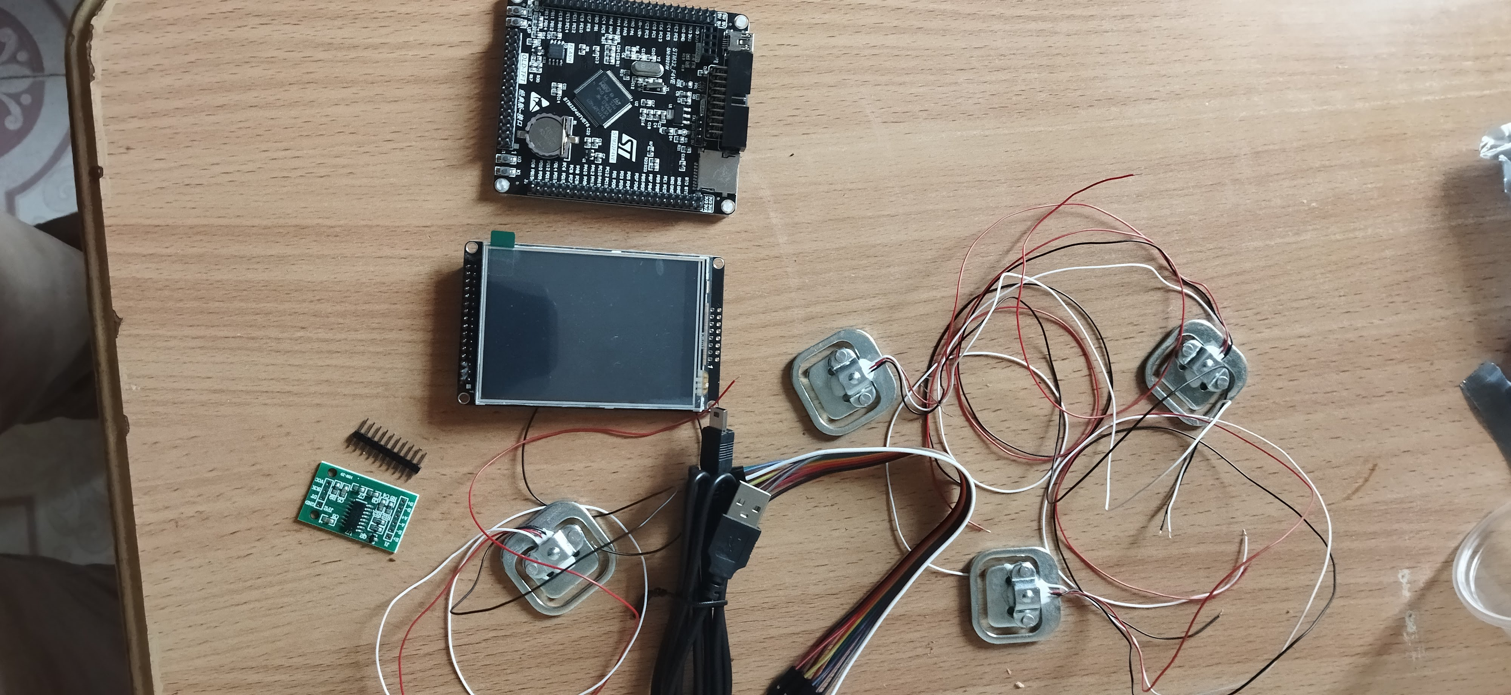
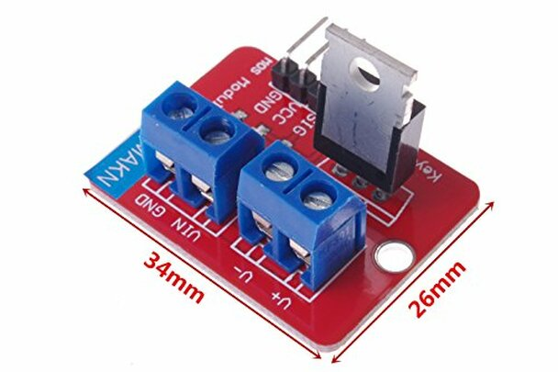
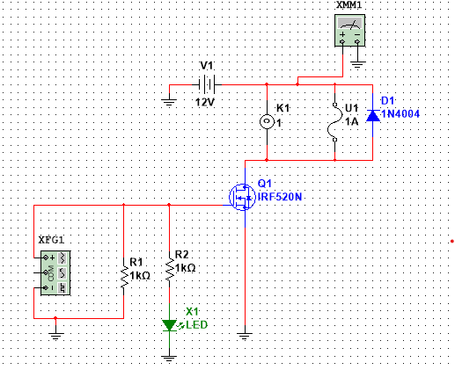
Design: Electrical and electronics
Electromagnetic Actuator
IRF520 MOSFET Driver module
STM32F407VET6
Other components
LCD touch 320x240 (ILI9341)
Load cells (50kg)

Slide 18
Software and control

Slide 19
Expected Outcomes
Discharge flow control
- Can turn the ball valve in precise steps.
- Accuracy of the steps is to the nearest whole number.
Discharge collection unit
- Synchronized discharge collection with temperature and weight measurements.
Flow diversion unit
- Accurate collection of the stream within the time interval.
Discharge collection tank.
- Correctly shaped for accurate weight measurement.
- Utilize gravity to eliminate the need for an extra pump.
Control and display
- Ergonomic Display
- Capable board

Slide 20
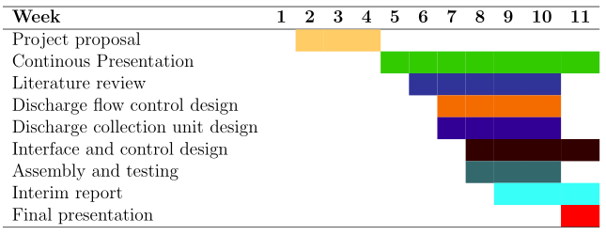
Time plan

Slide 21
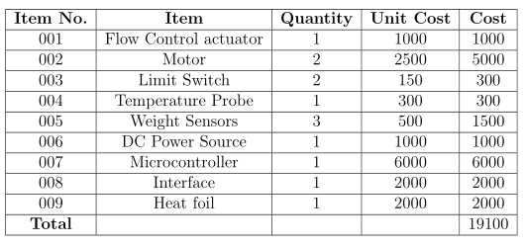
Budget

Slide 22
Way forward
Refine the designs.
Fabrication logistics.
Procurement of electrical and electronic components.

Slide 23


